Slide 1

Presented by: Dawn McKenney, Consultation Program Manager

Slide 2

SafetyWorks!
Best Kept Secret…But it Shouldn’t Be
We Are From The Government & We’re Here To Help
It’s True! We are!
SafetyWorks! is a program to help small employers develop and improve safety and health programs
OSH Act 1970
Our goal is to reduce/eliminate injuries, fatalities, and workers’ comp cost for Maine workplaces and workers
We Are Not OSHA! Provided at no cost! No penalties!
We Are Not OSHA!

Slide 3
Required S & H Programs
Hazard Communications
Lockout / Tagout (LO/TO)
Bloodborne Pathogens (BBP)
Confined Spaces
Hearing Conservation
Emergency Action Plan (EAP)
Personal Protective Equipment Assessment (PPE)
Respiratory Protection
Process Safety Management
Fire Prevention Plans
Hazardous Materials
Commercial Dive Teams
Notes:
Info box is hyperlinked to our sample programs

Slide 4

Training
Workers have a right to get training from employers on a variety of health and safety hazards and standards that employees must follow in a language and vocabulary workers can understand
Notes:
Fire Prevention
Material Handling
Hazardous Materials
Traffic Control
Emergency Action Plan
Workplace Violence
Bloodborne Pathogens
Before doing any job task, the employee shall be trained on the hazards associated and means of protection.

Slide 5
Required Training/Documentation
Video Display Terminal (I & A)
Bloodborne Pathogens (I & A)
Confined Space (I & A)
Fire Extinguishers (A)
  If expected use or based on task, i.e. welding, fire fighter
Fire Prevention (I)
Powered Industrial Trucks
  3yr recertification & evaluation
Emergency Action Plan (I)
Hazard Communications (I)
PPE (I)
LOTO (I)
  Authorized people observed performing (A)
Respirators (I & A)
Fall protection (I)
I-Initially Upon Hire A-Annually
Retraining shall be done, if:
Incident/Near Miss/Change in Process/Change in Expectations
Notes:
Refer students to the OSHA website, publication, regarding regulations that need or require training.

Slide 6
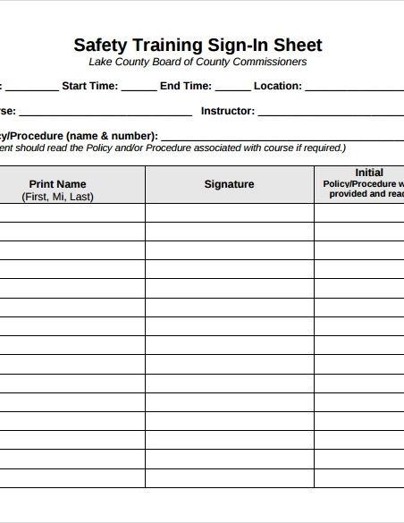
Training Documentation
Date
Location
Course
Instructor
Topic
Attendee Names
Do not allow employees perform tasks or use
equipment until they are trained.

Slide 7
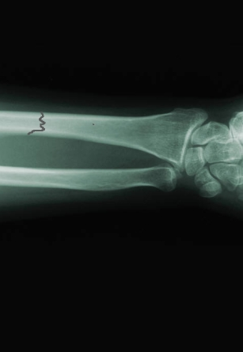
Illness & Injury Recording & Reporting
Maintain 300/300A/301 Logs
Post 300A 2/1 – 4/30
10 or more employees
Some industries not required to maintain logs. 1904.2 Appendix A
OSHA Injury Tracking Application
  1) 250 or more employees and is not in an industry listed in the Exempt Industries list in Appendix A to Subpart B of OSHA’s recordkeeping regulation of 29 CFR Part 1904 or
  2) 20-249 employees and is in an industry listed in Appendix A to Subpart E of 29 CFR Part 1904.
  YOU MUST also submit 300/301 data if your establishment(s) has 100 or more employees and is in an industry listed in Appendix B to Subpart E of 29 CFR Part 1904.
This Photo by Unknown Author is licensed under CC BY-NC-ND

Slide 8
OSHA Recordable vs Reportable Injury Illness
Any work-related fatality.
Any work-related injury or illness that results in loss of consciousness, days away from work, restricted work, or transfer to another job.
Any work-related injury or illness requiring medical treatment beyond first aid
Any work-related diagnosed case of cancer, chronic irreversible diseases, fractured or cracked bones or teeth, punctured eardrums
Reporting and recording requirements for OSHA and Workers’ Comp are not the same
Recommend working with a workplace healthcare provider

Slide 9
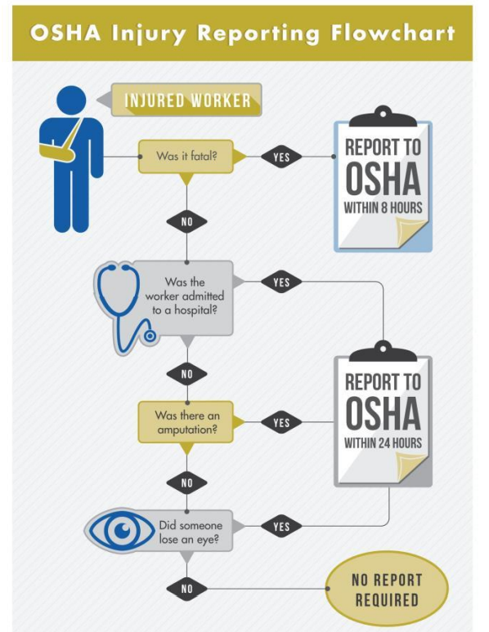
OSHA Recordable vs Reportable Injury Illness

Slide 10
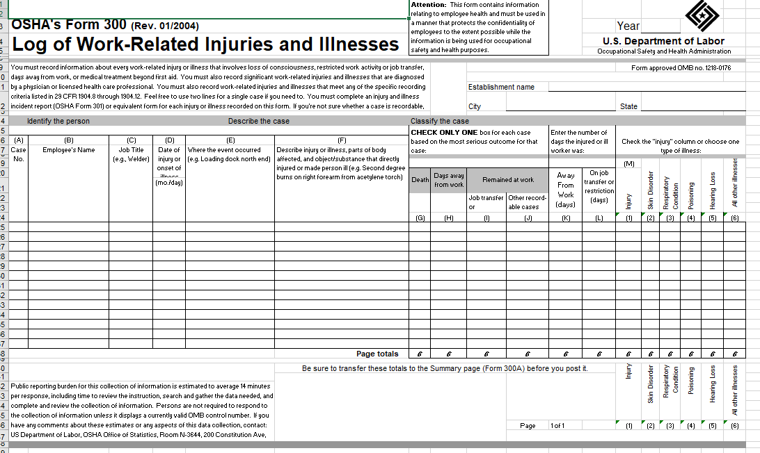

Slide 11
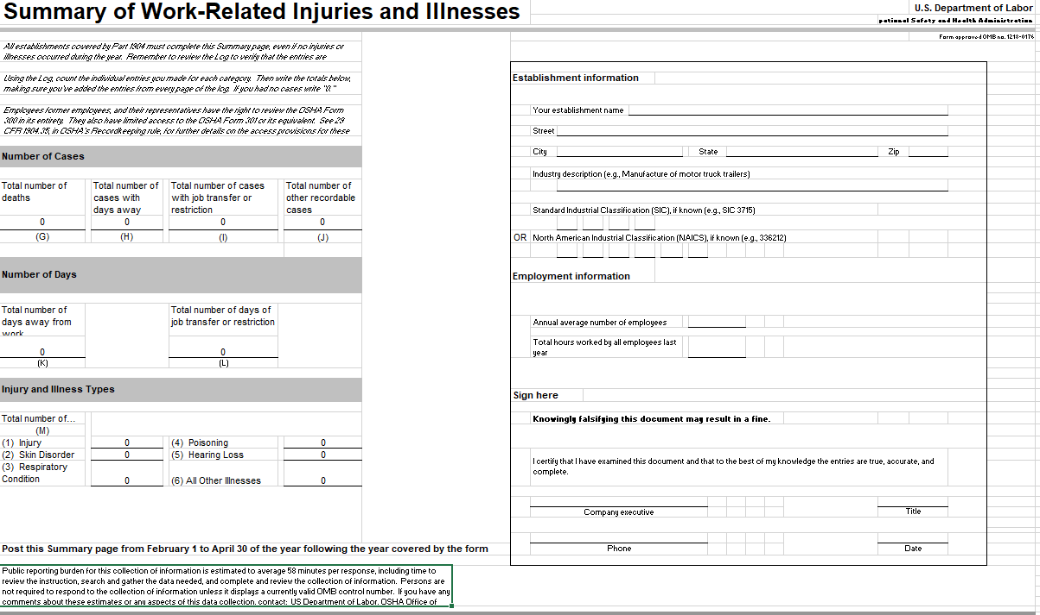

Slide 12
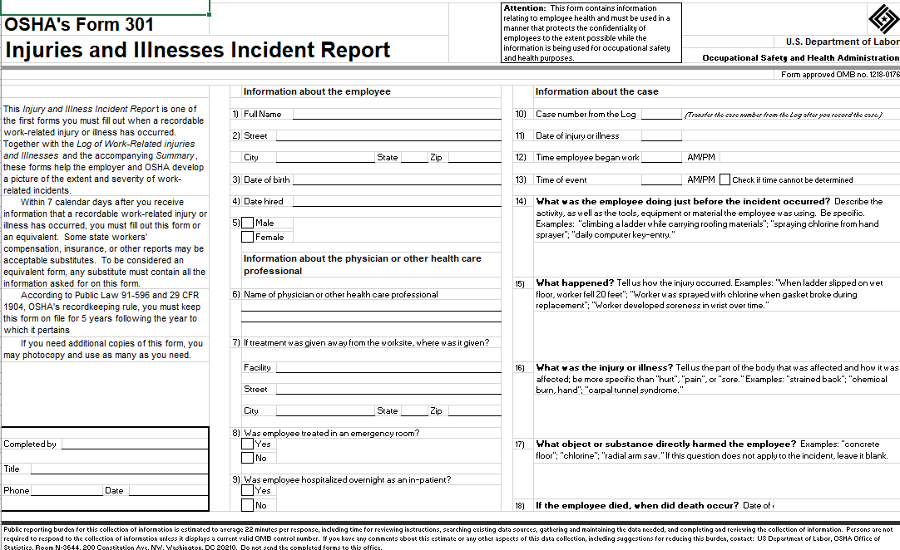

Slide 13
Common Hazards
Improper Use of Ladders
Not or improperly labeled containers
Powered Industrial Trucks
Electrical
Housekeeping/Walking Working Areas
Emergency Warning & Fire Protection Systems
Compress Gas Tanks
Air and Noise Health Hazards
Fall Protection

Slide 14
Consultations Provided At No Cost
Review mandatory programs
Review training programs
Conduct safety and health surveys
Review Illness and Injury Logs
Air Sampling
Noise Sampling
Employer is obligated to correct any hazards found by the mutually agreed upon correction date.

Slide 15
Training Provided At No Cost
SafetyWorks! Training Institute
Calendar
Authorized 10 & 30 Trainers for General Industry, Construction and Maritime
Hazard Communication
Powered Industrial Trucks
Fall Protection
Ladders
Personal Protective Equipment
…so much more
SafetyWorks! Training Institute, local CareerCenters, or at your facility

Slide 16

How to access our services or find additional information?
www.SafetyWorksMaine.gov
www.osha.gov

Slide 17

Questions?
Comments?
Concerns?

Slide 18



Contact Information
Dawn McKenney, Program Manager
Maine Department of Labor – SafetyWorks!
Dawn.L.McKenney@Maine.gov
Main Line (207) 623-7900
Direct Line (207) 623-7920
Toll-free 1 (877) SAFE 345 (723-3345)
www.safetyworksmaine.gov

