Slide 1
ECVSP 25 and Operational Plans

Slide 2
What is an ECVSP?
ECVSP is the Electronic Commercial Vehicle Safety Plan.
-Framework for spending MCSAP Grant funds.
-All 50 states have plans online to view.
-All plans have been approved by FMCSA for disbursement of funds on actionable activities and purchases.

Slide 3
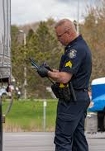
8 Areas of Focus
-Driver Inspections
-Vehicle Inspections
-Traffic Enforcement
-Investigations – CR’s
-New Entrant Safety Audits
-Border State CMV Safety Programs
-PRISM Program Participation
-Data Collection and Reporting

Slide 4
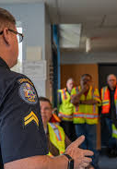
Action Plans and Enforcement ‘25’
-Eastern Service Center Initiatives
-Operation ORCA / PC Details
-D.R.I.V.E. details
-Work Zone Speed Details
-Operation Water Buffalo

Slide 5
Eastern Service Center Initiatives
Eastern Service Center Crash Reduction Initiative. October 20th through October 24th.
-Goal is crash reduction in rural areas.
Level 1 - 75 Level 2 - 122 Level 3 - 109 Level 5 – 3 Total:309
OOS Driver – 19 OOS Vehicle – 34 Violations - 346

Slide 6
Eastern Service Center Initiatives
Operation Hot Shot. October 28th through October 30th.
-Goal is to target high risk carriers on the interstate and back roads of Maine.
Level 1 - 30 Level 2 - 46 Level 3 - 54 Level 5 – 0 Total:130
OOS Driver – 14 OOS Vehicle – 22 Violations - 181

Slide 7
Eastern Service Center Initiatives
Eastern Service Center Crash Reduction Initiative. November 3rd through November 7.
-Goal is crash reduction in rural areas.
Level 1 - 71 Level 2 - 98 Level 3 - 112 Level 5 – 0 Total:298
OOS Driver – 21 OOS Vehicle – 33 Violations - 307

Slide 8
Operation ORCA
(Other-Vehicle Risks to Commercial Autos)
Targeting high volume CMV areas with passenger car enforcement to reduce PC initiated CMV fatalities.
Quarter 1 - 52 Traffic Stops with 24 citations
Partnership with DOT to gain their training and use their equipment to supplement our enforcement activities.

Slide 9
D.R.I.V.E. Detail
(Distracted Reckless Impaired Visibility Enforcement)
01/13/26 – 01/14/26
Technology sites for advanced screening with FMCSA partners.
390 Inspections with 80 OOS violations
Focus on Hazmat carriers operating in extension of Emergency order with HOS relief.

Slide 10
Work Zone Details with Troop I
Two details in the last two weeks:
79 Traffic Stops
70 citations
Speeds ranging from 15 mph to 33 mph over the posted work zone limit.

Slide 11
Operation Water Buffalo
Kingfield area enforcement 10/01/25-02/18/26:
132 Inspections 20 OOS Driver 8 OOS Vehicle
Hollis area enforcement 10/01/25 – 02/18/26:
24 Inspections 6 OOS Driver 4 OOS Vehicle

Slide 12
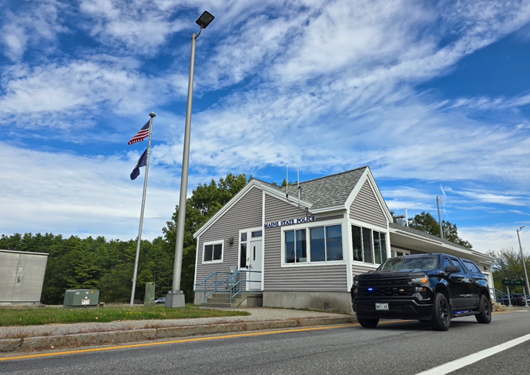
Lt. Randall Keaten
207-816-0392
Randall.m.keaten@maine.gov

