Slide 1
Fitness For Duty
Provided by:
Marilyn Wornell
Manager, J.D. Irving, Limited

Slide 2
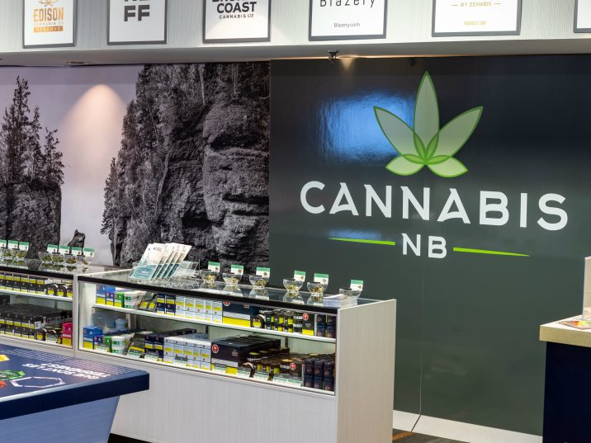
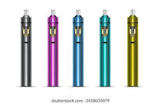

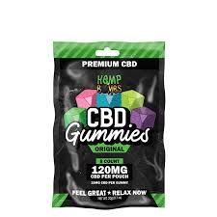

Slide 3
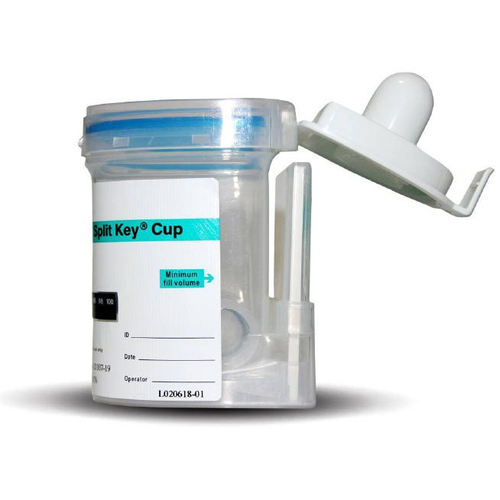
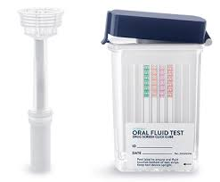
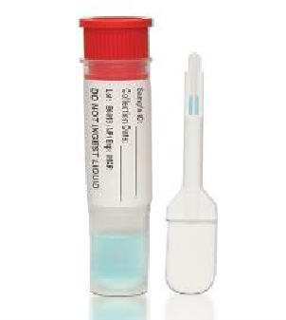
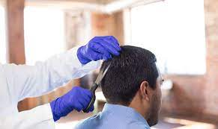
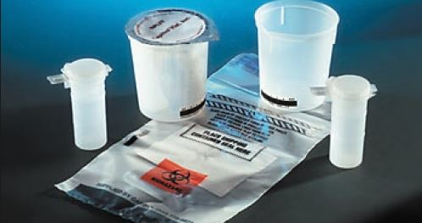
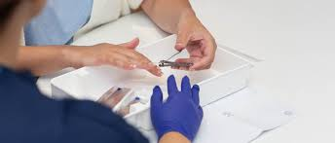
Testing Options
Urine – Point of Care or Lab based
Oral Fluid – Point of Care or Lab based
Hair
Nails

Slide 4
Interpreting Test Results
Results can tell you:
Presence of a substance
Timeframe of use (range)
Increased risk
Compromised fitness for duty
Likely impairment
Results can not tell you:
Actual amount used
Frequency of use
Specific time of use
Route of ingestion
History of use
Definite impairment

Slide 5
After Legalization in Canada
Case study:
After cannabis legalization, the prevalence of moderately injured drivers with a THC level of at least 2 ng per milliliter in participating British Columbia trauma centers more than doubled. The increase was largest among older drivers and male drivers.

Slide 6
Canadian Centre Substance Abuse report
The weight of evidence clearly reveals significant psychomotor impairment as a result of cannabis use. Individuals with more experience in using cannabis may be more aware of their intoxication and impairment.
Attempts to compensate may be at the expense of vehicle control — for example, speed control, lane position variability, reaction time — reflecting deficits in the ability to allocate attention.
Individuals who regularly use cannabis my also develop a degree of tolerance to the effects of the drug and may display less impairment than people with less experience

Slide 7
Key Points from report
• Driving after using cannabis is more prevalent than driving after drinking, particularly among young drivers.
• Cannabis impairs the cognitive and motor abilities necessary to operate a motor vehicle and doubles the risk of crash involvement.
• Cannabis now rivals alcohol as the most commonly detected substance among drivers who die in traffic crashes.

Slide 8
Cannabis Tolerance ?
Tolerance does not necessarily develop to all drug effects at the same time nor does it completely eliminate all performance deficits. Moreover, if cannabis use is no longer producing the same effects as a consequence of acquired tolerance, the person is likely to increase the dose of cannabis to reinstate the desired effects.

Slide 9
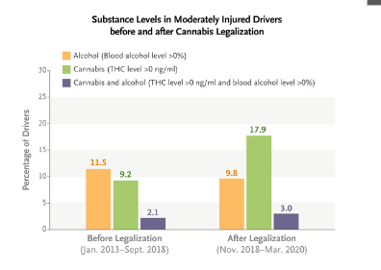
Injured Drivers – BC Study
Blood samples were collected an average of 116 minutes after the collision, so measured THC levels were lower than the levels at the time of the collision.
Cannabis Legalization and Detection of Tetrahydrocannabinol in Injured Drivers Brubacher JR et al. DOI: 10.1056/NEJMsa2109371

Slide 10
Results from BC Study
Before cannabis was legalized, 3.8 per cent of drivers had blood THC concentrations above the Canadian legal driving limit of 2 nanograms/ml. That percentage rose to 8.6 per cent after legalization.
The proportion of drivers with higher concentrations of THC (above 5 nanograms/ml) also increased, going from 1.1 per cent pre-legalization to 3.5 per cent afterwards.

Slide 11
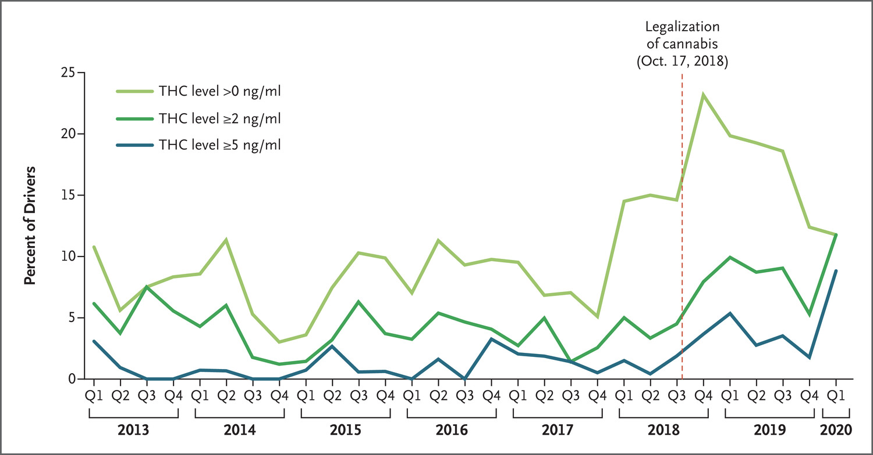
Post Legalization Results
Cannabis Legalization and Detection of Tetrahydrocannabinol in Injured Drivers Brubacher JR et al. DOI: 10.1056/NEJMsa2109371

Slide 12

Cannabis and driving in Canada
Table 4 – Trends in annual, police reported incidents involving drug-impaired driving in Canada, by age group, 2015 – 2022
Age group | Year |  |  |  |  |  |  | Percent Change 2015-2022
 | Pre-legalization |  |  | Post-legalization
 | 2015 | 2016 | 2017 | 2019 | 2020 | 2021 | 2022
12 – 17 | 56 | 54 | 59 | 77 | 57 | 54 | 36 | -35.71%
18 – 24 | 578 | 698 | 711 | 673 | 885 | 720 | 479 | -17.13%
25 – 34 | 824 | 955 | 1,083 | 1,242 | 1,882 | 1,943 | 1,314 | 59.47%
35 – 100 | 1,134 | 1,230 | 1,304 | 1,927 | 2,476 | 2,998 | 1,975 | 74.16%
Total | 2,592 | 2,937 | 3,157 | 3,919 | 5,300 | 5,715 | 3,804 | 46.76%

Slide 13

Standard Drug Testing Panel
Marijuana - THC
Cocaine
Amphetamines/Methamphetamines : Ecstasy MDA, MDMA
Opioids: Heroin Morphine, Codeine
Phencyclidine (PCP)

Slide 14
Quest Diagnostics – US statistics
Post-accident Marijuana Positivity Continues to Climb
In 2023, post-accident marijuana positivity of urine drug tests in the general U.S. workforce was 7.5%. The new peak follows a steady increase in post-accident marijuana positivity every year from 2015 to 2023. In that 9-year time frame, post accident marijuana positivity increased 114.3%.
The Quest data aligns with other reports associating marijuana legalization with workplace harms. A February 2024 study in the Journal of the American Medical Association (JAMA Health Forum) found recreational marijuana laws that allow recreational marijuana sales were associated with a 10% increase in workplace injuries among individuals aged 20 to 34 years.

Slide 15
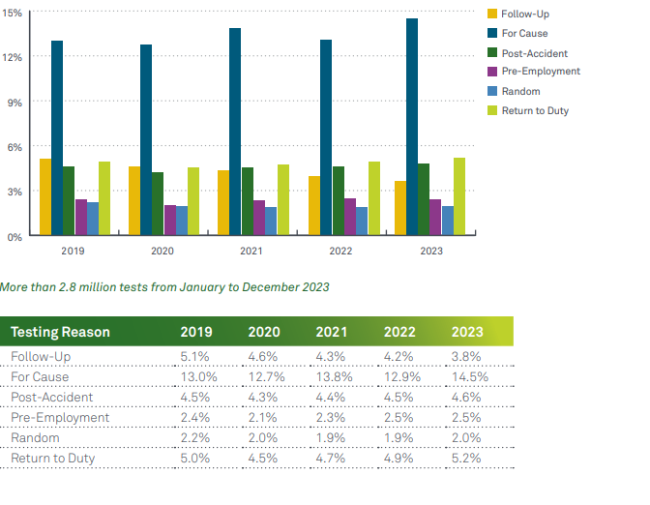
Quest Positivity Rate by Reason
Urine Drug Tests – For Federally Mandated, Safety-Sensitive Workforce

Slide 16
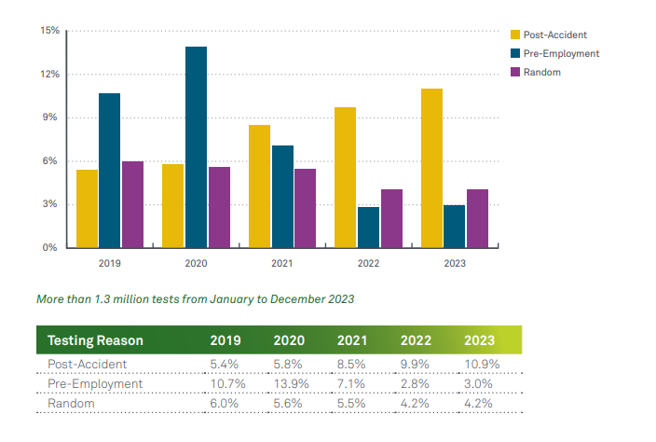
Quest Positivity Rate by Reason
Oral Fluid Drug Tests – For General U.S. Workforce

Slide 17
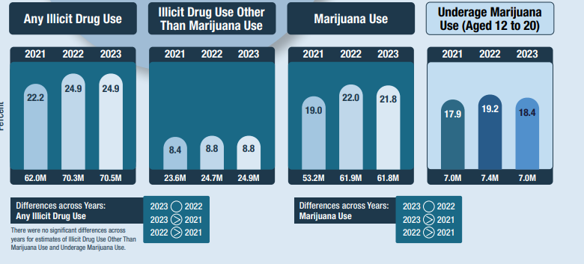
SAMHSA

Slide 18
Medication & Fitness For Duty
Impairment Impacts Safety
Impairment may be from illicit substances, legal substances or prescribed medications
Employers often focus on illicit (cocaine) and legal (alcohol & THC) but ignore other common substances
Health Care Professionals generally have little knowledge of the employees workplace when prescribing
Many of these substances of concern are regularly prescribed to your employees

Slide 19
Opioids
ACOEM guidelines relating to Safety Sensitive Work
Acute or chronic use of opioids is not recommended for Safety Sensitive Work
Sufficient time after last dose is recommended to eliminate at least 90% of the drug and active metabolite (need to discuss with Health Care Provider or pharmacist)
What does this mean for daily or periodic use?
Also need to review what other medications are being used?

Slide 20
Opioid Tolerance ?
Tolerance does NOT indicate a lack of impairment
Employers & employees may have a general understanding of active use / impairment but not how long impairment may last?
Study conducted to see if tolerance had a role in collisions
Current use indicted increased risk compared with past use
No increased risk with new as compared with established users
The risks did not change over time – Tolerance did not play a role in the impairment risk
Brubacher et al, 2021. Medications and risk of motor vehicle collision responsibility in British Columbia, Canada: a population-based case-control study. The Lancet. Vol 6. DOI: https://doi.org/10.1016/S2468-2667(21)00027-X

Slide 21
What about Cannabis?
Medical use of cannabis in Canada – Health Canada process
Recreational use of cannabis
Impairment is a safety concern regardless of the reason - it is the same product
Some studies indicate “intention of use” has an effects
Cannabis is a complex substance; it is not like alcohol

Slide 22
Recreational Cannabis
Acute Impairment- immediate effect at time of consumption:
Oral – edibles- longer to have peak effect
Smoking / vaping
Some things to consider about effects:
Amount of THC in product
Frequency of use
Consumption method
Age when became a regular user

Slide 23
Residual Cannabis Impairment
Residual impairment is the impairment that can continue to occur after the initial period of intoxication (euphoria, when one feels the effects, the “high”) wears off
Users will often think they are “fine”
Impairment can exceed the acute impairment timeframe*
OEMAC suggests waiting 24 hours after use of cannabis to help mitigate risk
Dellazizzo L, Potvin S, Giguère S, Dumais A. Evidence on the acute and residual neurocognitive effects of cannabis use in adolescents and adults: a systematic meta-review of meta-analyses. Addiction. 2021;1–14. https:// doi.org/10.1111/add.15764

Slide 24
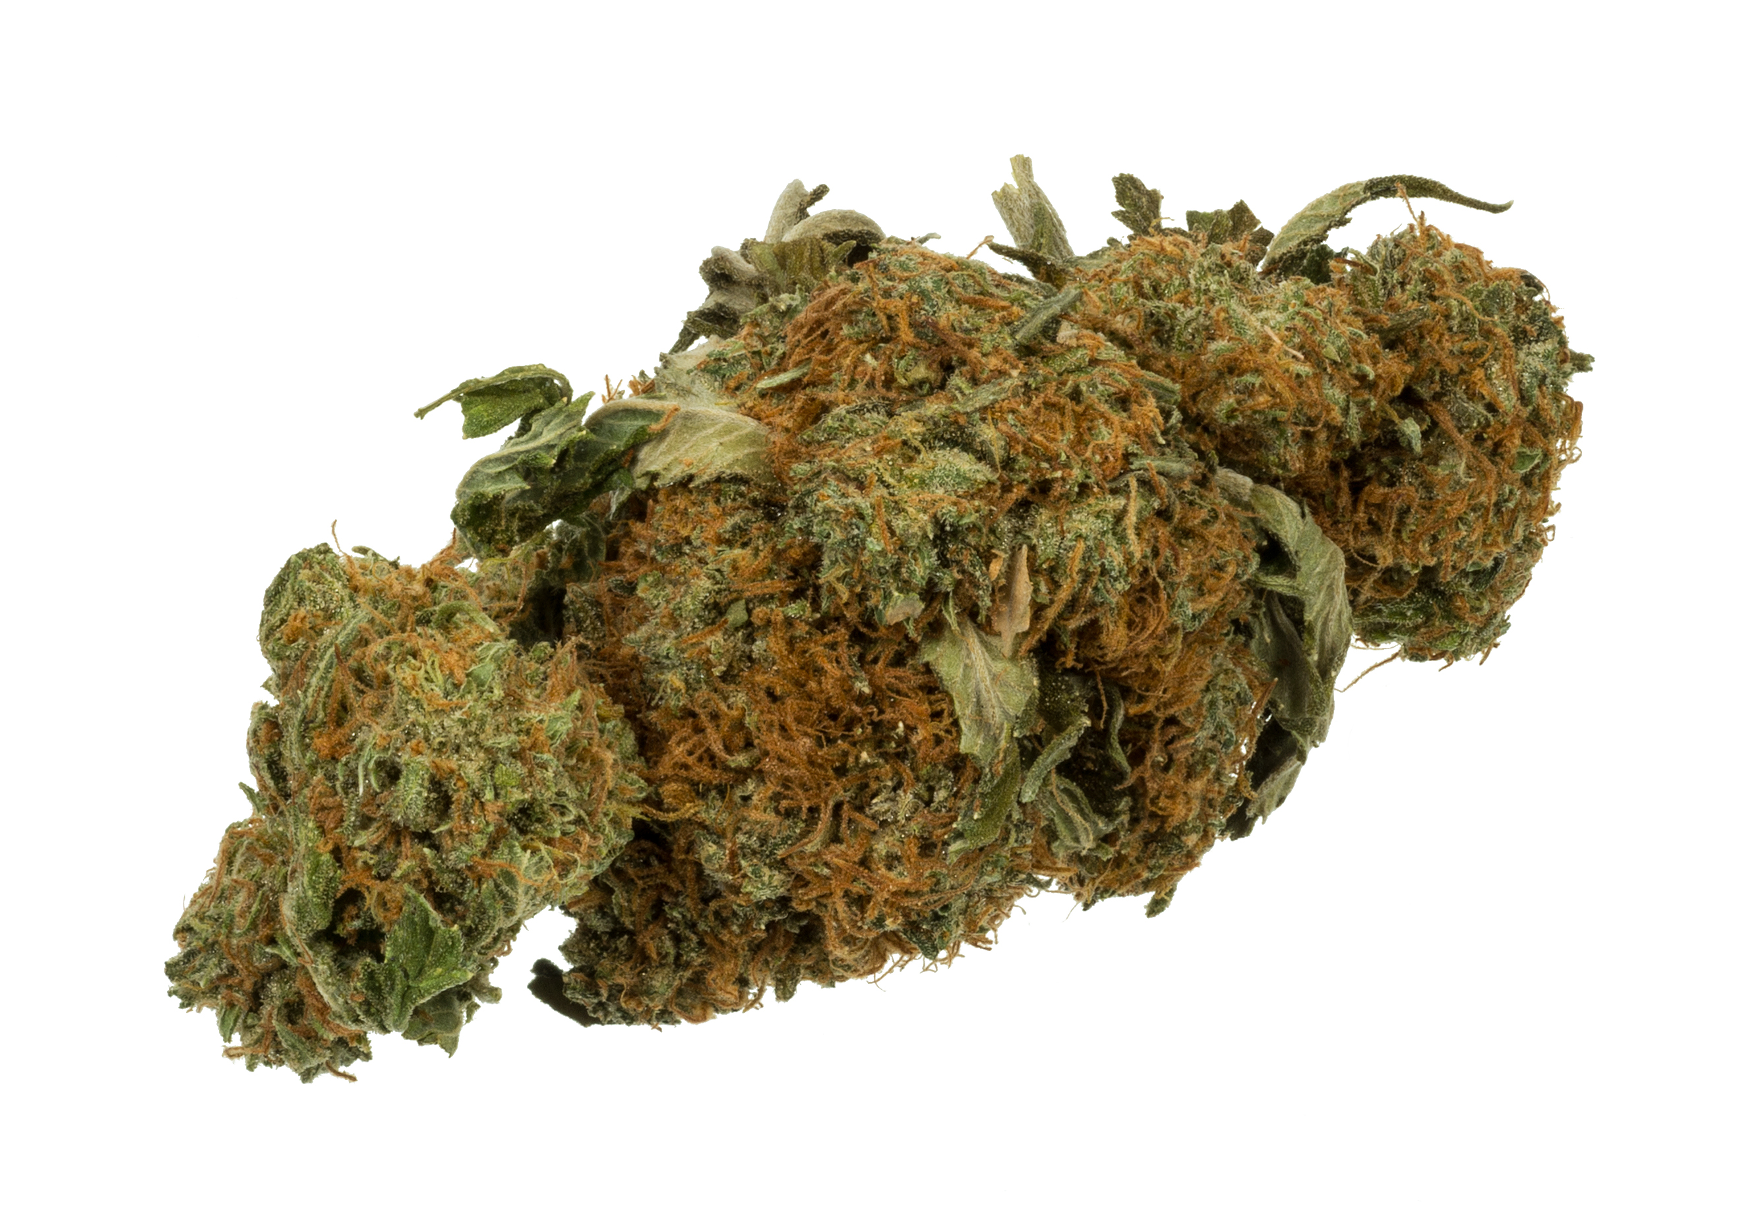
Cannabis Safety Concerns
Slowed Speech
Slowed response
Memory lapse / loss
Loss of drive
Loss of initiative
Decreased concentration
Difficulty learning new tasks

Slide 25
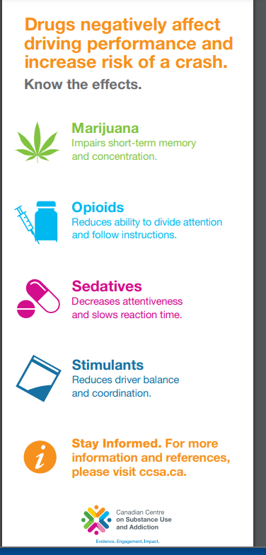
Know the Effects

Slide 26
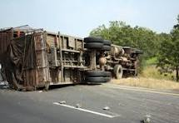
Questions?
Cannabis is one of many impairing substances
Legal , recreational or medical cannabis may be in your area
Fitness for duty = Safety
Tolerance is a complicated topic
Don’t ignore long term cannabis use effects

