Slide 1
Maine Motor Transport Association
November 19, 2020

Slide 2
Monthly Summary Report– October 2020
Registrations
Queries
Violations Reported to Clearinghouse
Return-to-Duty Processes

Slide 3
Registrations
Registration for the FMCSA Drug and Alcohol Clearinghouse (Clearinghouse) began for all user roles on September 28, 2019. User roles include: drivers, employers, consortia/third-party administrators (C/TPAs), medical review officers (MROs), and substance abuse professionals (SAPs).

Slide 4
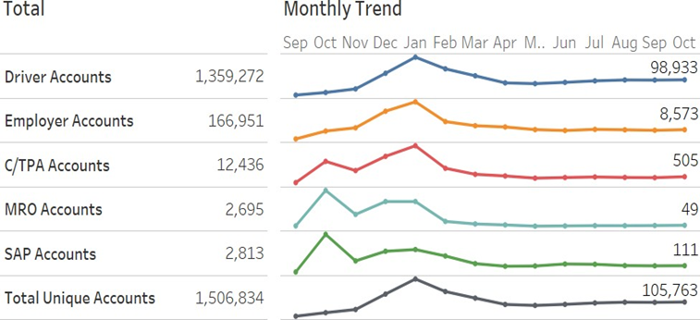
Registrations – By the Numbers

Slide 5
Registrations

Slide 6
Queries
Employers are required to conduct queries in the Clearinghouse when hiring a new commercial driver’s license (CDL) holder and annually for all CDL drivers they currently employ.
  Pre-employment Queries > Full Queries > Consent provided within the Clearinghouse
  Annual Queries > Limited Queries > Consent provided outside the Clearinghouse

Slide 7
Queries – By the Numbers

Slide 8
Violations Reported to the Clearinghouse
Reporting Entity | What Information will be reported to the Clearinghouse
Prospective/Current Employer of CDL Driver Or their designated C/TPA | An alcohol confirmation test with a concentration of 0.04 or higher. Refusal to test (alcohol) as specified in 49 CFR 40.261.
 | Refusal to test (drug) not requiring a determination by the MRO as specified in 49 CFR 40.191.
 | Actual knowledge, as defined in 49 CFR 382.107, that a driver has used alcohol on duty, used alcohol within four hours of coming on duty, used alcohol prior to post-accident testing, or has used a controlled substance.
 | Negative return-to-duty test results (drug and alcohol testing, as applicable)
 | Completion of follow-up testing.
MRO | Verified positive, adulterated, or substituted drug test result (Within two business days of making a determination or verification of a DOT-approved drug test)
 | Refusal to test (drug) requiring a determination by the MRO as specified in 49 CFR 40.191 (Within two business days of making a determination or verification of a DOT-approved drug test)
 | Changes a verified drug test per 49 CFR part 40 (Within one business day of making any change in the reported results)

Slide 9
Violations Reported to the Clearinghouse

Slide 10
Violations Reported to the Clearinghouse

Slide 11
Violations Reported to the Clearinghouse

Slide 12
Violations Reported to the Clearinghouse

Slide 13
Return-To-Duty Process

Slide 14
Important Reminders
Pre-employment drug tests CANNOT be considered a refusal until the seal of the specimen cup is broken
Employers should NOT be duplicating violations
The 1st annual query must be completed no later than 01.05.2021
A pre-employment query must be a full query
Consent for a limited query is done outside the Clearinghouse and kept on file with the carrier
FMCSA is the ONLY place to purchase queries
Queries must be purchased by the employer
No sharing accounts

Slide 15
Questions?
Email: Clearinghouse@dot.gov
Phone: (844) 955-0207
Local FMCSA Field Office
  Maine: (207) 622-8358

